Slide 1
AGE IN ALL INVESTMENTS: Discovering new opportunities to deepen your philanthropy Lindsay A. Goldman, LMSW CEO, Grantmakers In Aging Maine Philanthropy Center, 9/15/21

Slide 2
Mission
Network
Champion
Resource

Slide 3
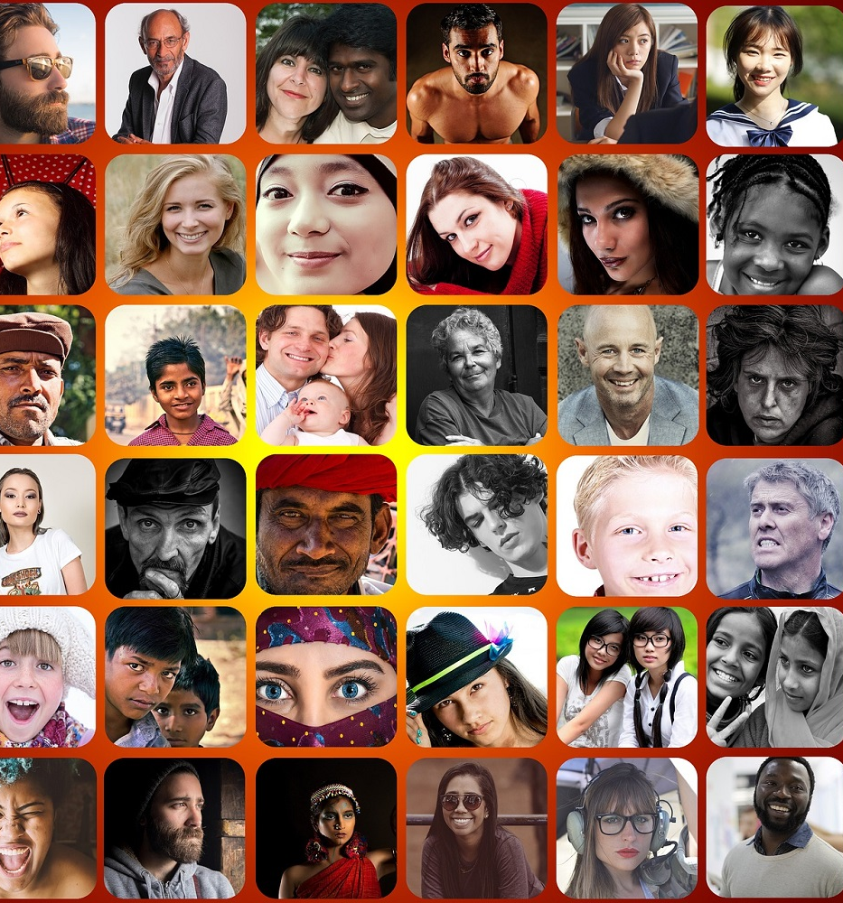
This is About All of Us
We are all aging--from the youngest to the oldest among us.

Slide 4
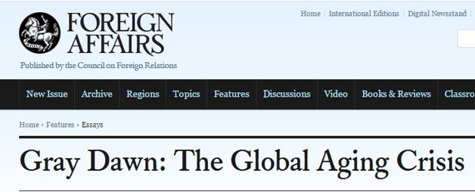
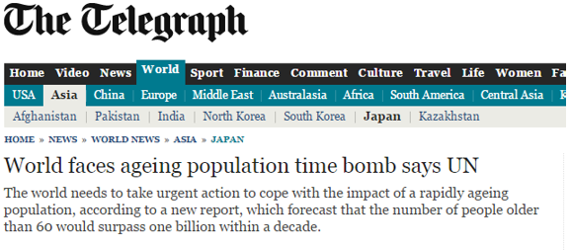
The Cultural Narrative

Slide 5
We Have a Few Blind Spots…
We don’t include older people when addressing problems.
We don’t consider older people when thinking about solutions.
We all suffer from implicit (or even explicit) ageism.
Society’s systems and structures were designed for a much shorter lifespan.
People do not have equal opportunities to age well.

Slide 6
Time to Reconsider
Rethink our assumptions about older people
Reimagine a lifetime of work, community and purpose
Deepen our concern for all people, no matter their age, in our communities

Slide 7
Opportunities for Growth-- Even Within Aging Philanthropy
Few national and other funders focused solely on older adults
“Only 1-2% of private philanthropy”

Slide 8
“Aging’s Not Our Thing”
“We don’t do aging, we do (insert issue here).”
“We have new priorities and are no longer focused on aging.”
“We focus on health/gender/racial equity, not aging.”

Slide 9
What We Can Do The Aging Lens
Consider: How might older adults be integrated into your existing funding?

Slide 10
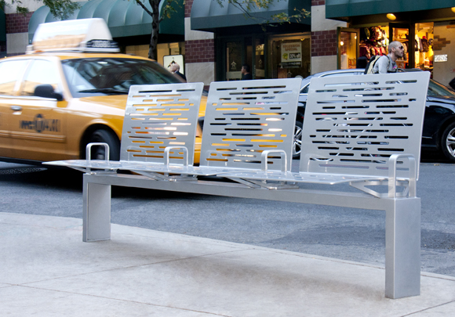
Applying the Aging Lens: Transportation
Photo by Heather Clayton Colangelo https://www.exceedingexpectations.nyc/hank

Slide 11
Applying the Aging Lens: Education & Workforce

Slide 12
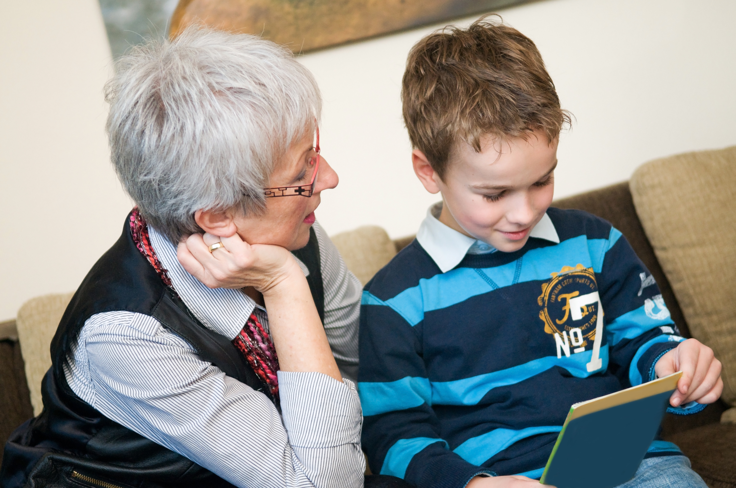
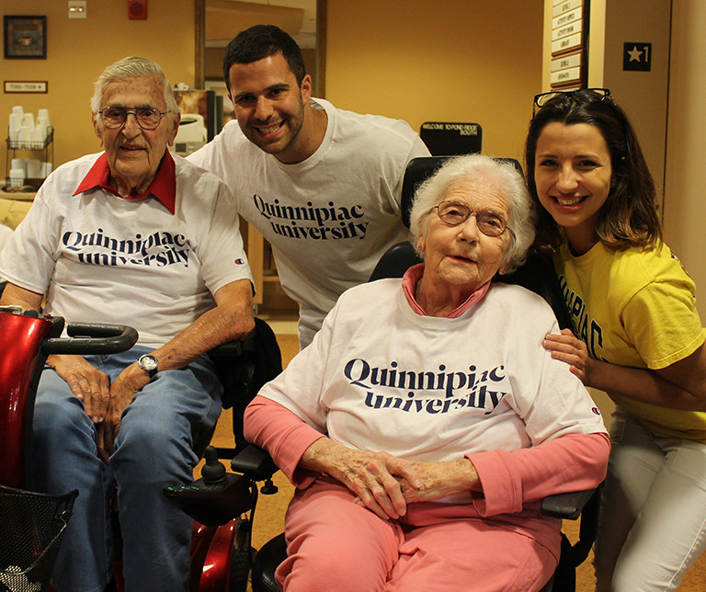
Applying the Aging Lens: Kids & Families
Older people as educators and advocates
Younger people serving older people

Slide 13
Applying the Aging Lens: Economic Development
“Articulate the policies in place that increase the livability and quality of life of the downtown. Examples include the use of local land banks, modern zoning codes or New York State Stretch Code, comprehensive plans, Clean Energy Communities or Climate Smart Communities designation, complete streets plan, transit-oriented development, non-discrimination laws, age-friendly policies, and a downtown management structure. If policies that support livability and quality of life in downtown are not currently in place, describe near-term efforts by the municipality to create and implement such policies.”

Slide 14
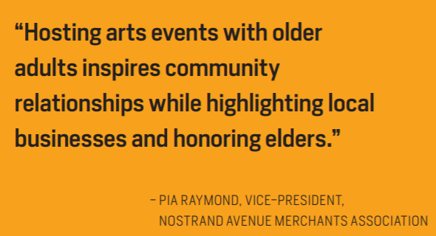
Applying the Aging Lens: Arts & Culture

Slide 15
Applying the Aging Lens: Participatory Grantmaking

Slide 16
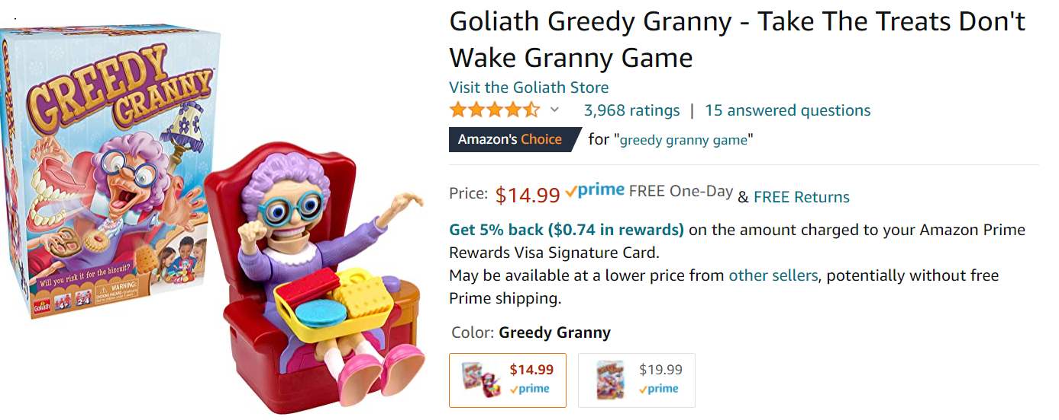
Raising Anti-Ageist Crusaders
https://youtu.be/QroRcADCLrU

Slide 17
Stay in Touch
https://www.linkedin.com/company/grantmakers-in-aging-gia/
@giaging
lgoldman@giaging.org

